Slide 1

Software Development Workflows
Praveen Kumar Suggula
praveenkumarsuggula@my.unt.edu

Slide 2
Agenda
Development cycle
Web Development
Major Stacks and Frameworks
Git, git flow and its basic commands
GitHub and its available actions (Demo)
DevOps Cycle
DevOps CI/CD with GitHub and Azure App services
Conclusion

Slide 3
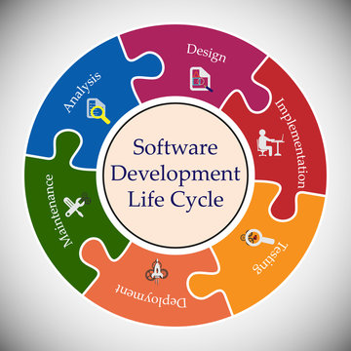
Development Cycle
The software development lifecycle (SDLC) outlines several tasks required to build a software application. The development process goes through several stages as developers add new features and fix bugs in the software.

Slide 4





Full Stack Web Development
Software Engineer
Programming Language
Frameworks
Engineers
Purpose
Images -> Tool/IDE’s
DB Developer
Backend (API) Developer
UI/UX Developer
Frontend Developer
QA Engineer
Cloud Engineer
SQL Server
.Net Core
Angular (TS/JS)
Java
DevOps
Cloud Admin
Selenium
CI/CD
For Orchestration
SSMS
To create and maintain infrastructure like VPN, VM, App Services, SQL, Storage accounts, etc
For Automation Testing
For Relational Database
For Interacting DB with UI
For UI Designing
For User Interface
For User Interface

Slide 5



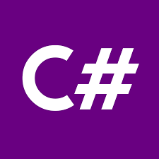















Major Stacks & Frameworks
Backend
API
Programming Language
User Interface
Quality Assurance(QA)
Cloud
Popular stacks

Slide 6
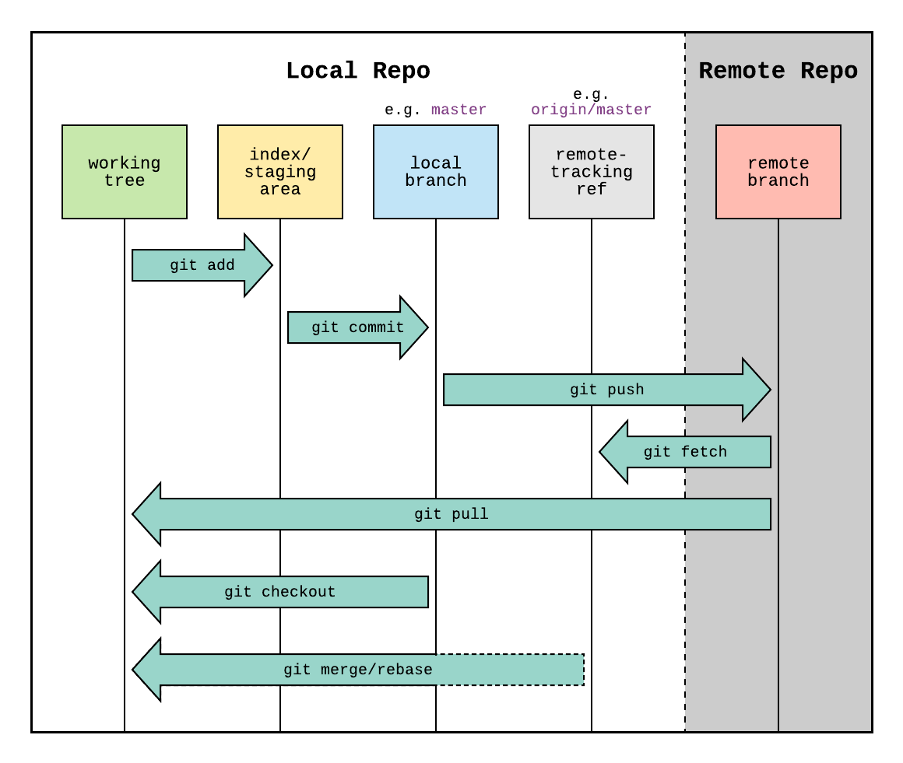
Git
Def: Git is a distributed version control system (DVCS) that allows developers to track, manage, and collaborate on changes to source code and other files. It records and maintains a history of these changes, making it easier to work on projects, collaborate with others, and manage different versions of the same codebase.

Slide 7

Git Flow
Local (In our laptop)
Server (Remote origin)
To Create
New Repository
Git revert
Git init
Git add
Git stage
Git commit
Git push
Git clone <url>
Git reset
To Copy Existing Repository

Slide 8

Git Commands
With Git Bash / cmd prompt:
git config git reset
git init git revert
git clone git tag
git add <file_name> git log
git stage git status
git commit git --help
git remote
git checkout <branch_name>
git branch
git pull
git push
git fetch
git merge <branch_name>

Slide 9

Git Hub & its Actions
It makes it easy for developers to share code files and collaborate with fellow developers on open-source projects. GitHub also serves as a social networking site where developers can openly network, collaborate, and pitch their work.
Open source code repository
Code browsing
Issue tracking
Wiki pages
Working Offline
Ignoring some files

Slide 10
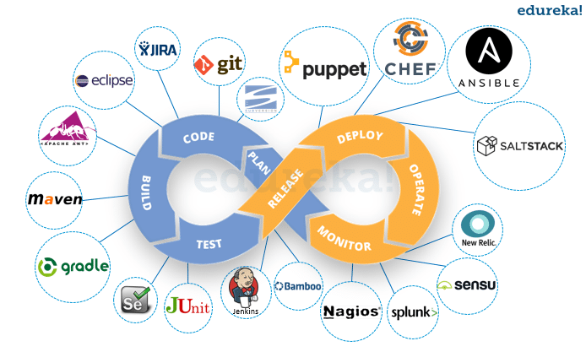
Devops Cycle

Slide 11
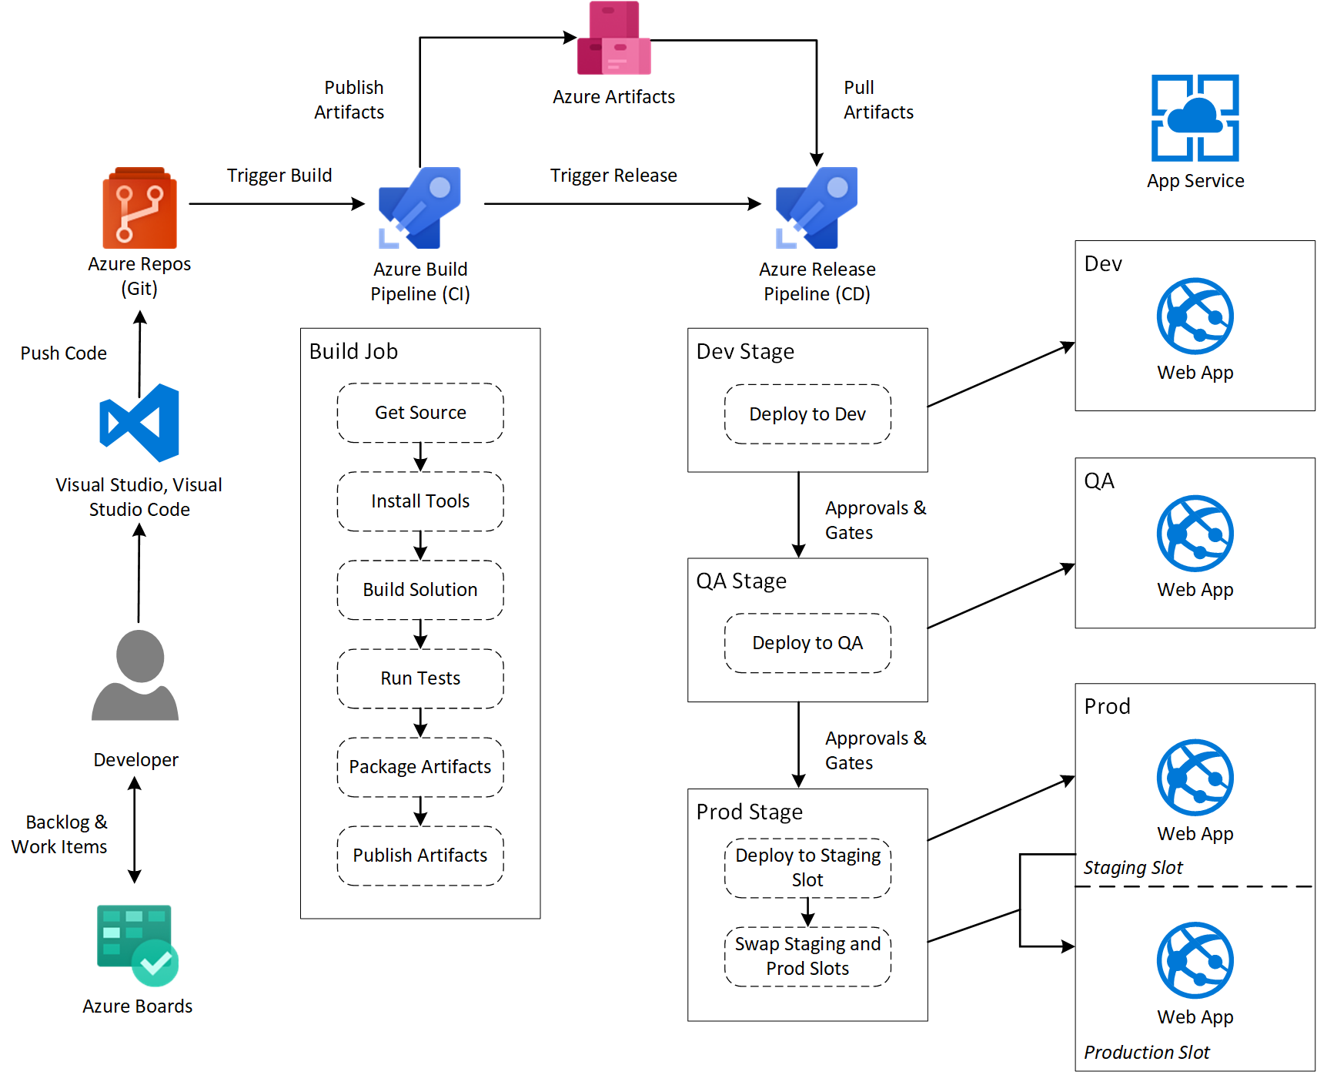
DevOps CI/CD

Slide 12
Conclusion
In this lecture, we learned about some development stacks and its tools, Git, GitHub, DevOps(CI/CD).
Every technology have its own advantages and dis-advantages too. We need to pick our tools and technologies based on our project architecture and our requirement.

Slide 13
Any Queries?

Slide 14
Thank You.

